Slide 1
Hope and Development of Hope
Notes:
https://www.youtube.com/watch?v=dlcU5uHMdTM

Slide 2
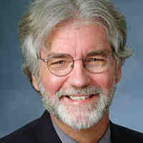
Hope is not a brand new concept in psychology.
In 1991, the eminent positive psychologist Charles R. Snyder and his colleagues came up with Hope Theory.
According to their theory, hope consists of agency and pathways.
Notes:
https://www.youtube.com/watch?v=ZuHZhi1B4T4

Slide 3
The person who has hope has the will and determination that goals will be achieved, and a set of different strategies at their disposal to reach their goals.
Hope involves the will to get there, and different ways to get there.
Notes:
https://www.youtube.com/watch?v=-MH2HNA4de4

Slide 4
Hope allows people to approach problems with a mindset and strategy-set suitable to success, thereby increasing the chances they will actually accomplish their goals.
Hope is not just a feel-good emotion, but a dynamic cognitive motivational system.

Slide 5
Under this conceptualization of hope, emotions follow cognitions, not the other way round.
Hope-related cognitions are important.
Hope leads to learning goals, which are conducive to growth and improvement.

Slide 6
Those lacking hope, on the other hand, tend to adopt mastery goals.
When they fail, they quit.
They have no hope.

Slide 7
People with mastery goals choose easy tasks that don’t offer a challenge or opportunity for growth.
People with mastery goals act helpless, and feel a lack of control over their environment.
They don’t believe in their capacity to obtain the kind of future they want.

Slide 8
Hope theory
Snyder, Irving & Anderson define hope as
“a positive motivational state that is based on an interactively derived sense of successful (a) agency (goal-directed energy) and (b) pathways (planning to meet goals)”.

Slide 9
Hope theory can be subdivided into four categories:
Goals that are valuable and uncertain are described by Snyder as the anchors of hope theory as they provide direction and an endpoint for hopeful thinking.
Pathway thoughts refer to the routes we take to achieve our desired goals and the individual’s perceived ability to produce these routes (Snyder, 2000).
Agency thoughts refer to the motivation we have to undertake the routes towards our goals.
Barriers block the attainment of our goals and in the event of a barrier we can either give up or we can use our pathway thoughts to create new routes.

Slide 10
Hope has been defined by Snyder (2002) as a learned thinking pattern, a set of beliefs and thoughts, involving two relatively distinct ways of thinking about a goal:
Agentic thinking involves thought related to one’s successful determination about reaching goals.
(e.g., “I meet the goals that I set for myself”).
2. Pathways thinking involves thoughts about one’s effective abilities to pursue different means of obtaining goals
(“I can think of many ways to get what I want”).

Slide 11
Hope is also one’s belief in the ability to pursue goals.
To engage in such thinking it is necessary to first establish goals.
Second, hopeful thinking requires approaching with effective pathways for reaching the desired goals.
Third, we need the motivation to use the pathways that will bring us the goals.

Slide 12
GOALS:
Goals are the targets of mental action sequences, and they provide the cognitive component that anchors hope theory
Goals may be short- or long-term, but they need to be of sufficient value to occupy conscious thought.
Likewise, goals must be attainable, but they also typically contain some degree of uncertainty.

Slide 13
Pathways Thinking:
This process, which we call pathways thinking, signifies one’s perceived capabilities at generating workable routes to desired goals.
Likewise, we have found that this pathways thinking is typified by affirming internal messages.
“I’ll find a way to get this done!”

Slide 14
Agency Thinking:
The motivational component in hope theory is agency—the perceived capacity to use one’s pathways so as to reach desired goals.
Agentic thinking reflects the self-referential thoughts about both starting to move along a pathway and continuing to progress along that pathway.
It was found that high-hope people hold such self-talk agentic phrases as
“I can do this” and “I am not going to be stopped”

Slide 15






















Slide 16
Hope is goal-directed thinking (goals thinking) in which people perceive that they can produce routes to desired goals (pathways thinking) and the requisite motivation to use those routes (agency thinking)

Slide 17
Hope and Happiness
The three elements of hope include having goals (seeking out where you want to go), feeling empowered to shape your daily life, and identifying multiple pathways toward making your goals happen.
Working toward meaningful life goals is one of the most important strategies happy people utilize.
In one study, hope proved to be a strong predictor of satisfaction, leading the study’s authors to suggest that hope is a symptom of happiness.

Slide 18
Hope and Health
Correlational Evidence : Hope correlates positively with coping with severe burns, arthritis, spinal cord injury, acid-attack victims, and blindness.
Cross-sectional Evidence: Individuals with high (vs. low) hope remain energized during the recuperative process. High hopers also experience less pain and tolerate pain twice as long as low hopers.
Notes:
recuperative : healing

Slide 19
Hope and Academic Success
Cross-sectional Evidence: Individuals with high (vs. low) hope make adaptive attributions for success and failure. High hopers are more likely to graduate from college (40% of students with low hope completed college within 6 years whereas 50% of students with moderate hope and 57% of students with high hope achieved their goal of graduating).
Longitudinal Evidence: In a six-year study, hope scores of entering freshmen predicted better overall GPA even after controlling for entrance exam scores.
Notes:
Correlational Evidence: Hope scores of entering college freshmen predicted better overall grade point averages even after controlling for variance related to entrance examination scores.

Slide 20
Hope and Productivity
Hope and productivity go hand-in-hand.
Dr. Lopez summarizes the research as follows: “Hopeful salespeople reach their quotas more often; hopeful brokers process and close more loans; and hopeful managing executives meet their quarterly goals more often.”

Slide 21
Enhancing Goal Development

Slide 22
GOALS checklist
Be clear that the goal you set is one you really want.
Become more aware about making decisions about goals.
Rank your goals from most to least important.
Settle on two or three most important goals.
Make stretch goals in those goal arenas.
Give recognizable and concrete markers to important goals.
Put aside enough time for your important goals.
Set up your life so not always interrupted by outside demands
Before settling on goals, generate several in differing areas of your life (e.g., relationships, work, etc.).
Notes:
Stretch Goals is a term coined by Jack Welch at GE to denote those objectives which are seemingly unobtainable with present resources. By specifying the "unattainable", people are required to "think outside the box", and able to improve performance by a magnitude they had never thought possible.

Slide 23
PATHWAYS checklist
Practice making different routes, and select the best one.
Rehearse in your mind what you are going to do to reach goal.
Rehearse what you would do if you ran into an impediment (hindrance) .
Break a long-range goal into steps or subgoals.
If route doesn’t work, conclude that had wrong pathway, but don’t blame yourself or assume that you lack talent.
Recognize if you need a new skill and go get it.
Cultivate two-way friendships where you give and get advice.
Ask for help

Slide 24
AGENCY checklist
Talk to yourself in positive voices (e.g., ”I can do this!”).
Find a substitute goal when the original is impossible.
Enjoy the process of getting to your goals.
Attend to “little” things happening around you.
Consistently get physical exercise.
Rest through nightly - sleeping and daily relaxations.
Recall your previous successes, particularly when stuck
Be able to laugh at yourself.
Notes:
Cut back on caffeine, as well as cigarettes and alcohol.

Slide 25
“Our belief is in the power of hope.”
Walt Menninger (1999)
© Noel Strengths Academy

Slide 26
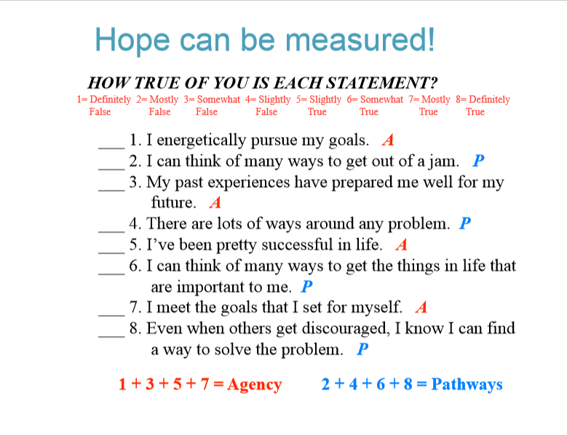

Slide 27
HERTH HOPE SCALE
There are a some statements regarding hope.
Listen to each statement and decide whether it applies to you personally.
There are no right or wrong answers.
There are four options:
      Never applies to me
      Seldom applies to me
      Sometimes applies to me
      Often applies to me

Slide 28


© Noel Strengths Academy

